Slide 1

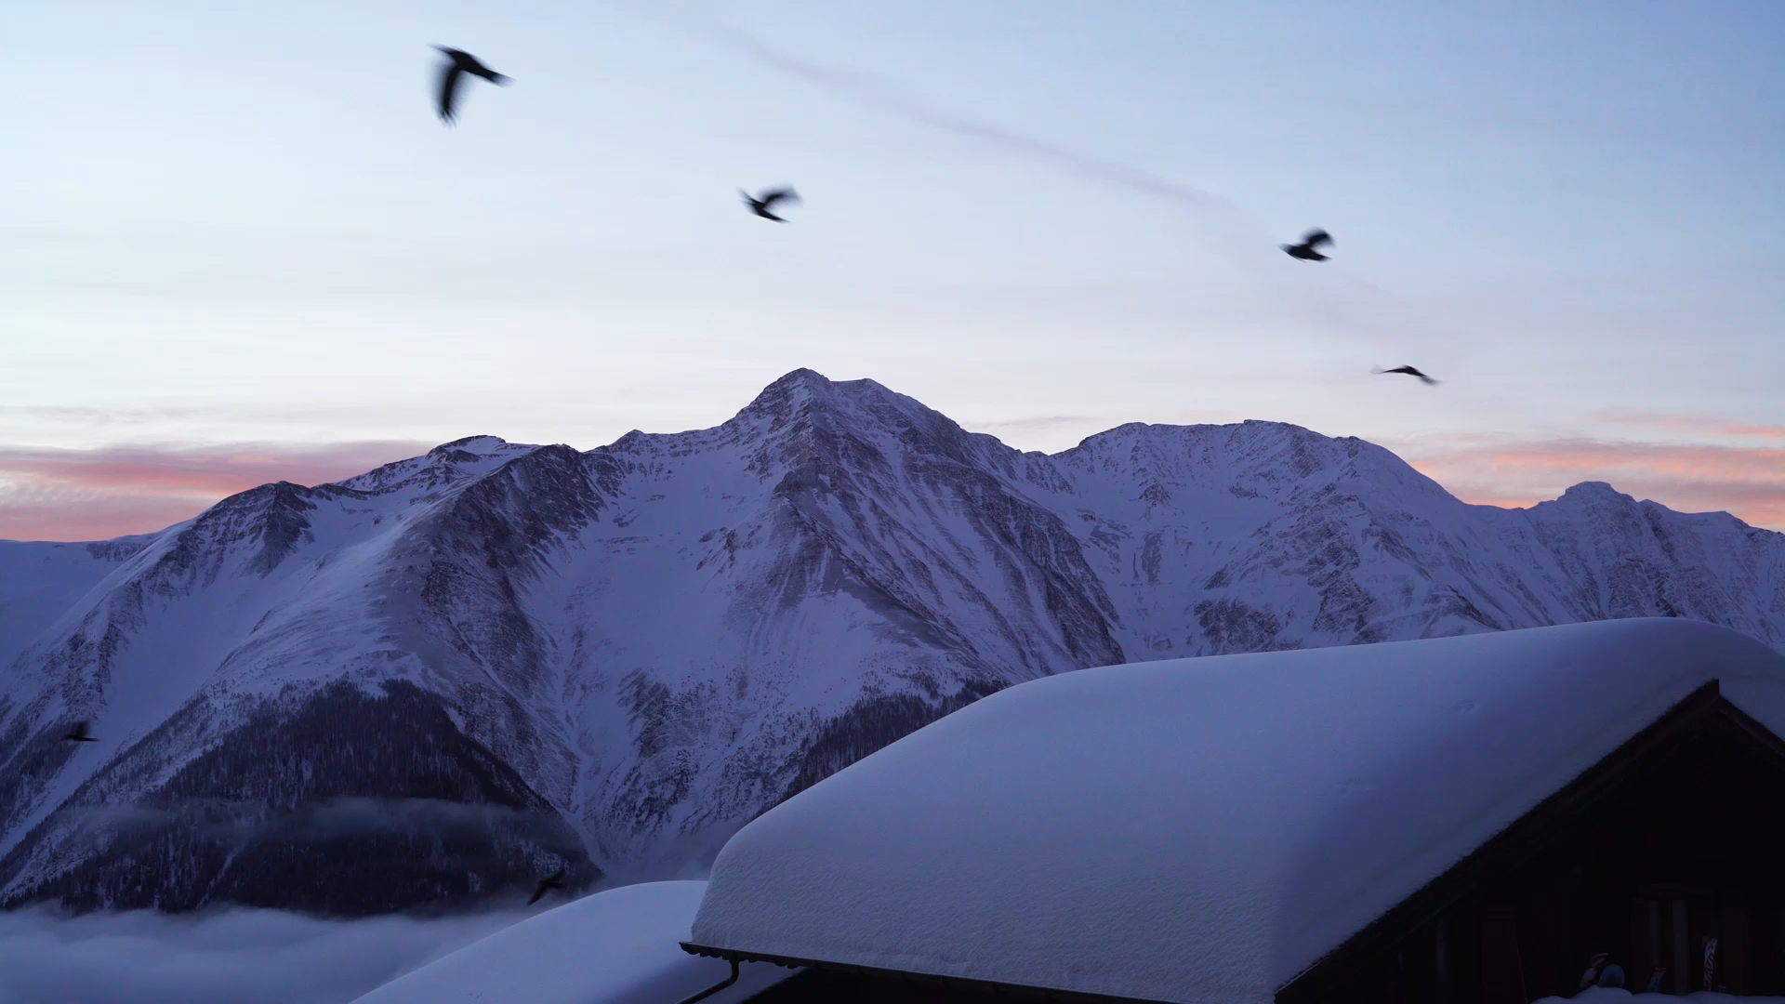
Big Mountain Resort
09/14/2022
Abdul Hannan

Slide 2
Problem Statement & Backstory
About Big Mountain Resort:
Big Mountain Resort offers spectacular views of Glacier National Park and Flathead National Forest, with access to 105 trails.
Every year about 350,000 people ski or snowboard at Big Mountain.
The Business has expressed its desire to generate more revenue by raising ticket prices, or cutting down on operational cost, but does not know what and how much to raise/cut prices/operational cost.
Problem Statement:
How can Big Mountain Resort:
Maintain their profit margin of 10% or more
Adjusting their ticket prices, operational costs
Offset the additional added chair expense, that increased their operational cost by $1.54M.

Slide 3
Missing Data
Our prices model is based on weekend prices only.
We do not know the total operational cost: cost for runs, snow making area, etc..

Slide 4
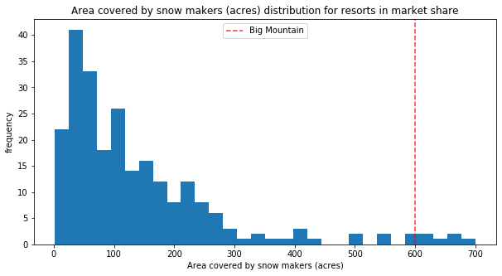
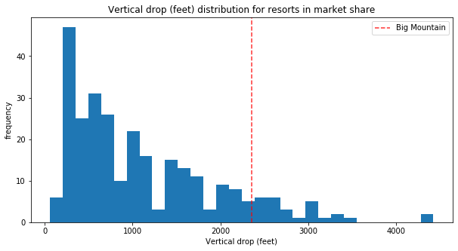
Big Mountain advantages:
Snow making area (600 acres)
Vertical drop (~2350 feet)

Slide 5
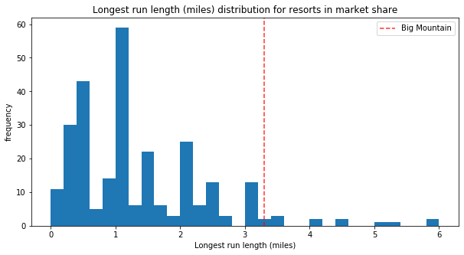
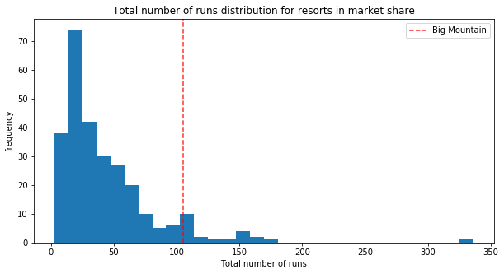
Resources
Big Mountain has one of the longest runs.
Big Mountain compares well for the number of runs. There are some resorts with more, but not many.
This also gives us an incentive to reduce the number of runs, which will result in reduction of our operational cost.

Slide 6
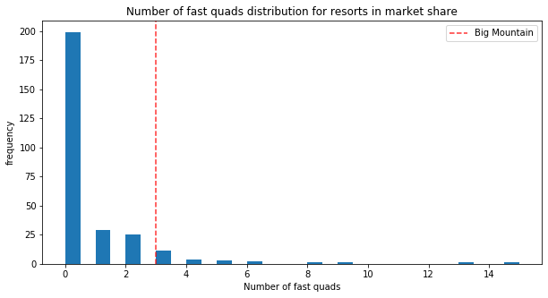
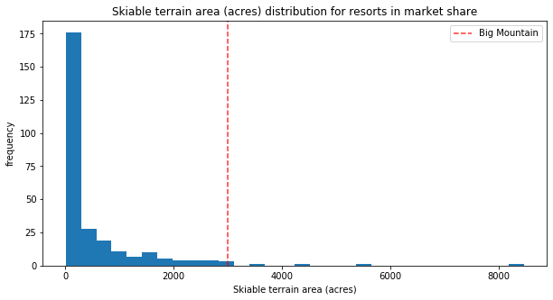
Resources
Most resorts have no fast quads, Big Mountain has 3.
Big Mountain is amongst the resorts with the largest amount of skiable terrain.

Slide 7
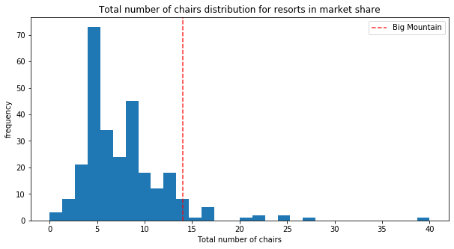
Resources
Big Mountain has a huge advantage on snow making area compared to others.
Big Mountain has amongst the highest number of total chairs.

Slide 8
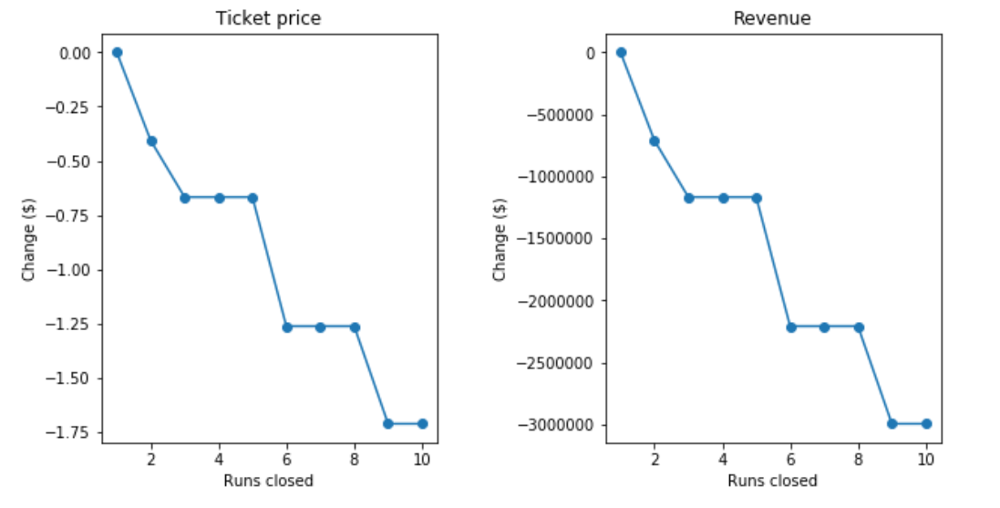
Resources
Closing one, two, or even five runs, doesn’t decrease much revenue. However, increasing the closures down to 6 or more leads to a large drop.
We will lose around $1.25M in revenue by closing 5 runs, however we will save from the reduction in the operational cost that comes with the runs.

Slide 9
Conclusion
Currently, the resort is undercharging tickets by $13.22 ($94.22 modeled price - $81 actual price)
Incorporating weekday prices can prove vital to making our model better.
Feature recommendations to increase ticket price:
Adding a chairlift
Adding another run
150ft drop (more if 2 acres of snow).
Dynamic pricing strategy.

Slide 10
Thank you! Discussion time

